Slide 1
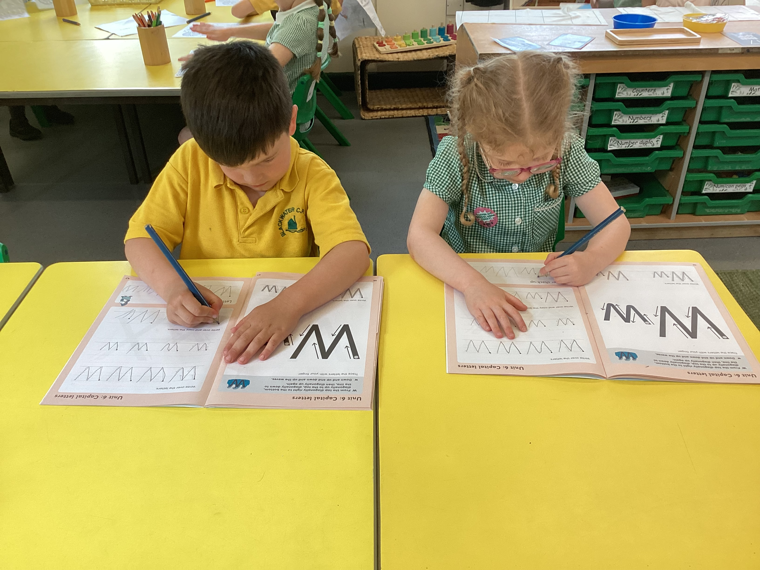
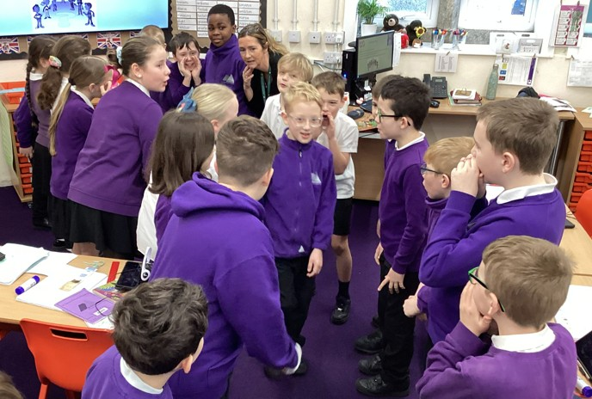
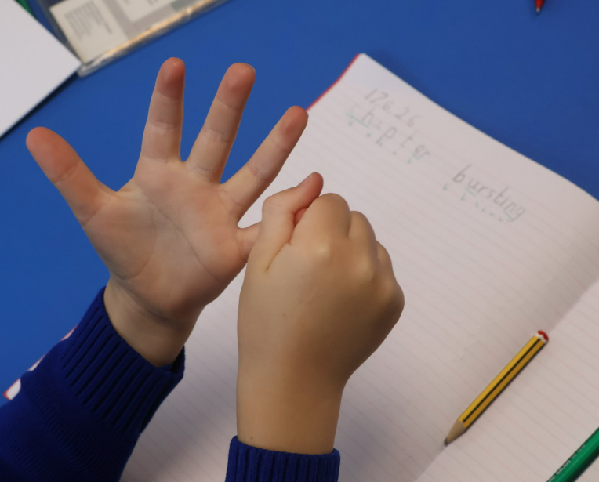
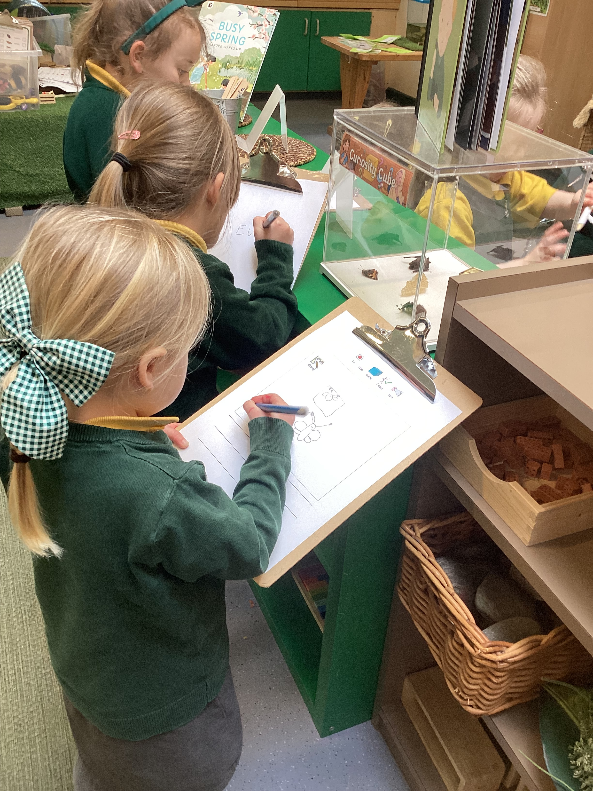
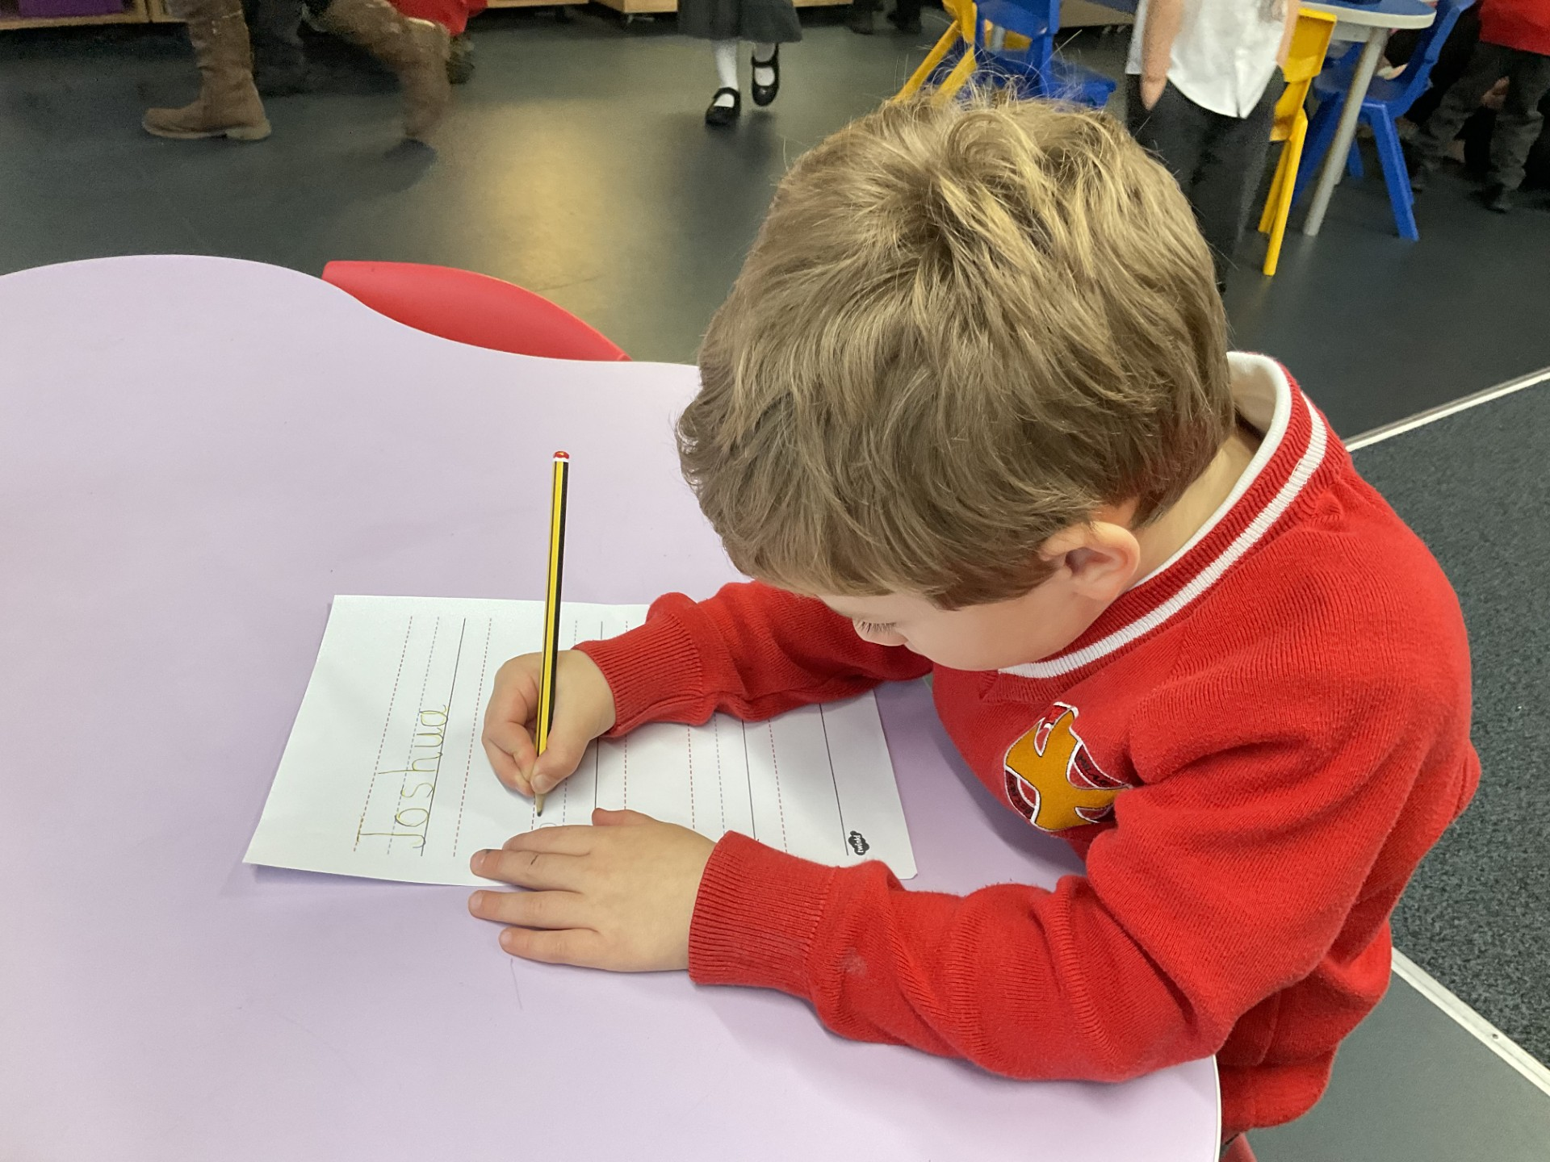

TPAT Writing Curriculum
“A curriculum designed by teachers for teachers.”

Slide 2
Contents
Page Number
2 | Contents
3 | TPAT Writing Curriculum Principles
5 | TPAT Writing Curriculum Process
6 | EYFS – Scribble it!
7 | EYFS – Drawing Club
8 | SEND – Colourful Semantics
9 | Overview
10 | Key Stage 1 Unit Structure
11 | Key Stage 2 Unit Structure
12 | Key Stage 1 Dictation
14 | Key Stage 2 Key Skills
16 | Progression in Oracy
18 | Handwriting
19 | Spelling
20 | Elements of Unit Structure
44 | KS1 Planning Grid
45 | KS2 Planning Grid

Slide 3
TPAT Writing Curriculum Principles
Writing for real purposes and audiences, with enjoyment.
Ideas and language that build through talk and reading.
Purpose
Ideas
Fluency
Development
Writing is shaped and refined over time.
Foundational skills enable all children to be writers.

Slide 4
TPAT Writing Curriculum Principles
The TPAT Writing Curriculum has been developed by teachers, for teachers, to ensure coherence, equity and high expectations for all pupils, while allowing schools the flexibility to reflect their own contexts, communities and texts.
By aligning our approach, we enable children to experience a consistent, high‑quality writing curriculum that progressively builds purpose, ideas, development and fluency.
The TPAT Writing Curriculum ensures that children write for real purposes and real audiences. Purpose and audience shape the content, tone, vocabulary and organisation of writing, helping children to make meaningful choices, increasing motivation and enjoyment.
Purpose
Pupils develop ideas, vocabulary and voice through rich talk, purposeful discussion and high‑quality reading. Oracy is explicitly taught and used to rehearse sentences, explore vocabulary and organise thinking before writing. Carefully chosen model texts and stimulus help children understand how writers use language to share ideas, supporting them to develop content with confidence.
Ideas
Writing is taught as a deliberate process of composition. Pupils learn how to plan, organise and develop ideas, construct sentences, paragraphs and create well-organised texts that are clear for the reader. They are supported to draft, reread, revise and improve their writing, understanding that effective writing develops over time rather than being completed in a single attempt.
Development
The TPAT Writing Curriculum focuses on building the foundational skills pupils need to access and enjoy writing. Through carefully sequenced teaching of handwriting, spelling and sentence construction, children develop fluency and confidence. As these skills become more secure, they are increasingly able to focus on their ideas and enjoyment in writing.
Fluency

Slide 5

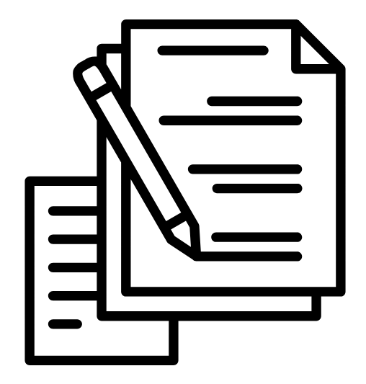

TPAT Writing Curriculum Process
1. Ignite and Immerse
Diagnostic Assessment
Hook
Purpose and Audience
Vocabulary and Oracy Development
Reading as Writers
3. Craft and Create
Planning
Drafting
Revising
Editing
Publishing
Assessment
2. Model and Master
Explicit Teaching of Skills
Short-Burst Writes
Modelled, Shared and Guided Writing
Reconstructing the Text

Slide 6

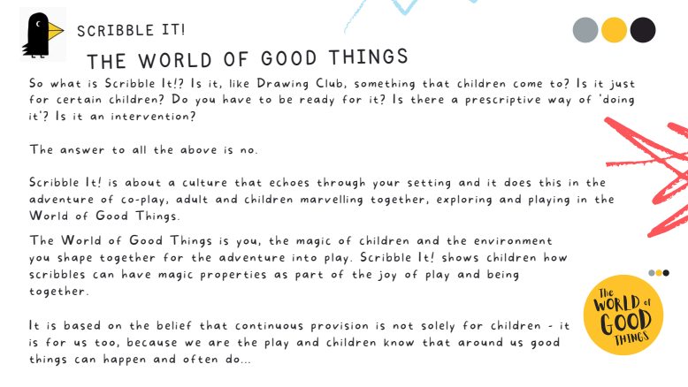

EYFS – Nursery – Scribble it!
In Nursery, we will use Scribble It! – an approach that values scribbling and its important role in early writing through co-play.
Scribble It! is designed for children aged 2, 3 and 4. It recognises scribbling as a key stage in early writing development. Rather than moving children too quickly towards formal writing, it encourages them to explore mark making freely and begin to understand that their marks have meaning.
Through shared play, children take part in talk, storytelling and imaginative experiences. In this context, scribbling becomes a way to communicate ideas, represent thinking and begin to tell stories.
Scribble It! highlights the strong link between early mark making, creativity and language development. Children start to see their marks as representations of characters, events and ideas. Adults support this by playing alongside children, modelling language, curiosity and interest, and helping them to attach meaning to what they create.
This approach strengthens the foundations for writing by developing physical control, creativity and communication in a way that is purposeful and developmentally appropriate
https://www.canigoandplaynow.com/store/p90/scribble-club.html

Slide 7

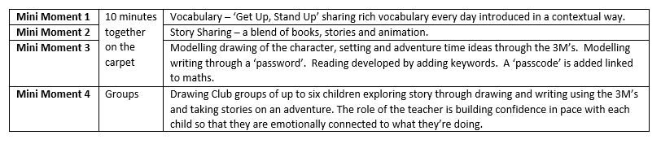
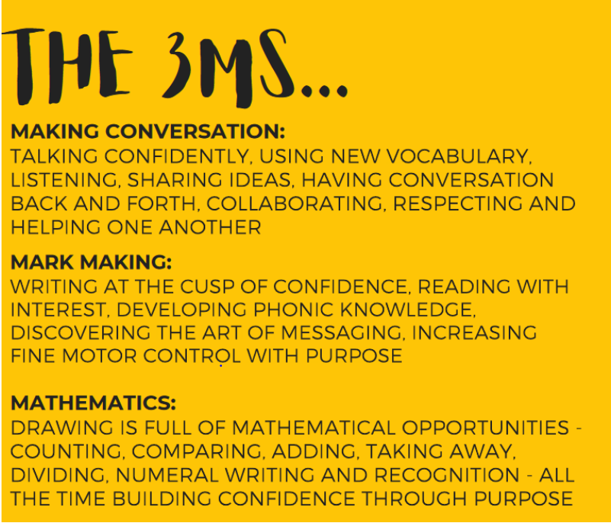
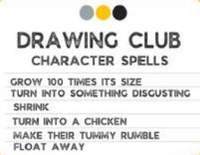
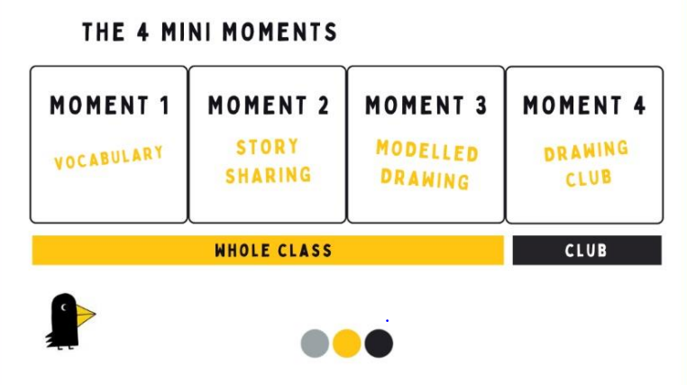
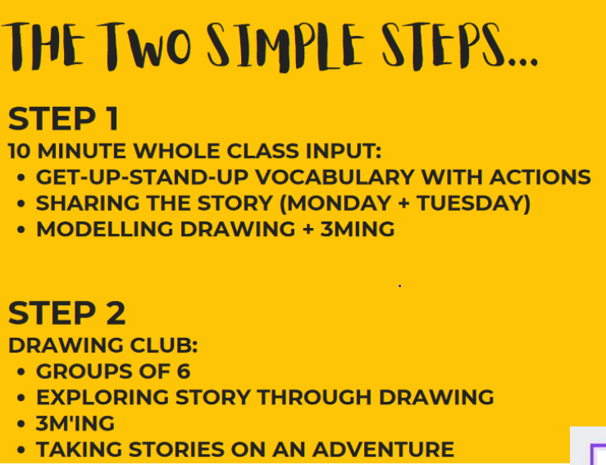
EYFS – Reception – Drawing Club
In EYFS, Drawing Club offers a structured, yet flexible, approach to supporting children’s development through stories and drawing. Using high‑quality picture books, tales and short animations, sessions begin with a short period of shared ‘Time Together’, where adults and children engage with a story as a group. This shared focus supports communication and language development and helps children build familiarity with stories, vocabulary and ideas. Children are then given time to explore their own responses through drawing, mark making and talk, which supports fine motor development, early writing skills and sustained engagement.
Drawing Club allows practitioners to adapt sessions to the needs of their cohort rather than following a fixed scheme. The approach encourages adults to introduce and revisit ambitious age‑appropriate vocabulary, model language and observe children closely as they develop ideas over time. As children return to stories and drawings, practitioners can gather meaningful evidence of progress in language, literacy, creativity and personal, social and emotional development.
Overall, Drawing Club supports EYFS practice by combining high‑quality texts, adult interaction and creative exploration in a way that is purposeful and engaging.

Slide 8
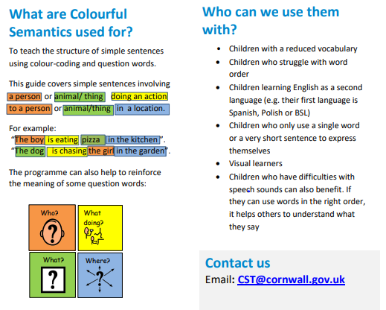
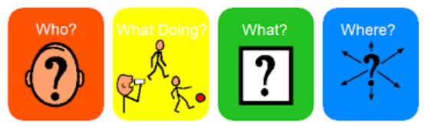
SEND – Colourful Semantics
Pupils with SEND are more likely to experience difficulty with writing because of challenges with oral language, sentence structure and working memory, rather than a lack of ideas.
An inclusive writing approach prioritises talk, visual scaffolds and explicit teaching of language structures so that all pupils can access writing tasks alongside their peers.
Approaches such as Colourful Semantics and structured talk reduce cognitive load, clarify meaning and support pupils to develop confidence and independence as writers.
In our writing curriculum, support for pupils with SEND is built into high‑quality classroom practice and strengthened through targeted interventions, enabling pupils to keep up rather than catch up.
Colourful Semantics is used as a key strategy to make sentence structure explicit by using colour‑coded visuals to break sentences into meaningful parts (who, what doing, what, where, when and why). This supports pupils with language and communication needs to construct complete, grammatically accurate sentences that can be rehearsed orally and transferred into writing.
Timely, focused interventions reinforce vocabulary, sentence construction and oral rehearsal, enabling pupils to apply these skills directly within whole‑class writing lessons, to ensure early, precise and purposeful support.

Slide 9
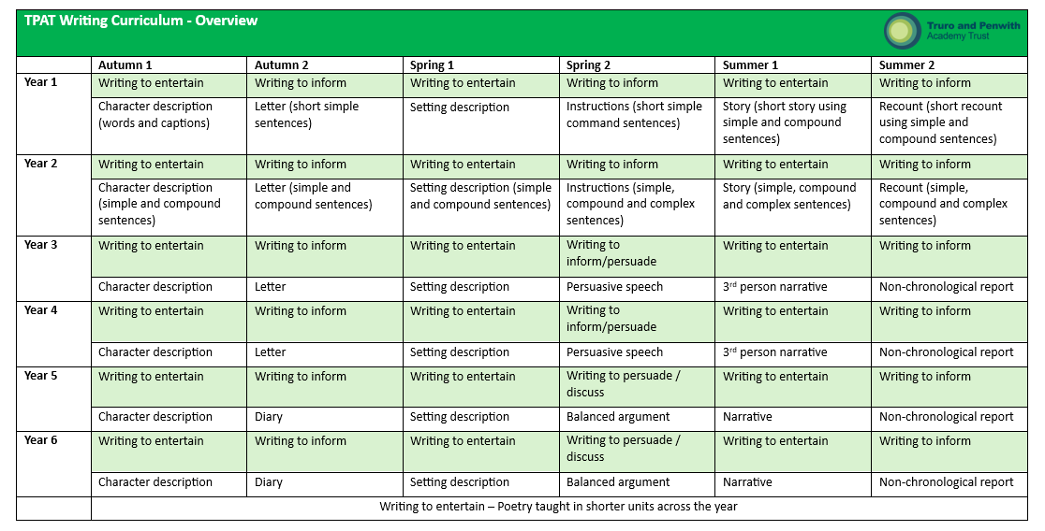
Overview
Early Writing: Reception
In Reception, early writing is underpinned by a systematic phonics programme - Read Write Inc (RWI) or Little Wandle alongside Drawing Club. The phonics scheme ensures pupils develop secure early reading and spelling skills, while Drawing Club supports oral language development, vocabulary, imagination and engagement with narrative. Together, these approaches lay strong foundations for composition, sentence building and transcription.
Transition into Year 1: Phonics and Early Writing
In Year 1, schools will continue with Read Write Inc or Little Wandle. Schools will also implement the Get Writing element of RWI or a programme created to sit alongside Little Wandle, to support the transition from sentence‑level work into extended writing. Drawing Club can continue alongside phonics in Year 1 if this best meets the needs of the cohort.
To further strengthen the relationship between phonics and writing, daily dictation is introduced in Year 1. This supports spelling, handwriting, sentence structure and application of phonics within meaningful written outcomes.
Once children have completed Little Wandle or the RWI Get Writing programme, they move onto the Trust’s agreed writing overview.
Writing for Purpose
The Trust writing overview focuses on writing for clear purposes, which remain consistent across year groups. This approach has been intentionally designed to support mixed‑age classes, ensure coherence and progression, allow flexibility in text choice and outcomes, and keep expectations clear and shared across TPAT.
While the purpose for writing remains the same in each year group, expectations for transcription, sentence structure, vocabulary and independence increase progressively. This ensures all pupils are working towards common goals while being appropriately supported and challenged.

Slide 10
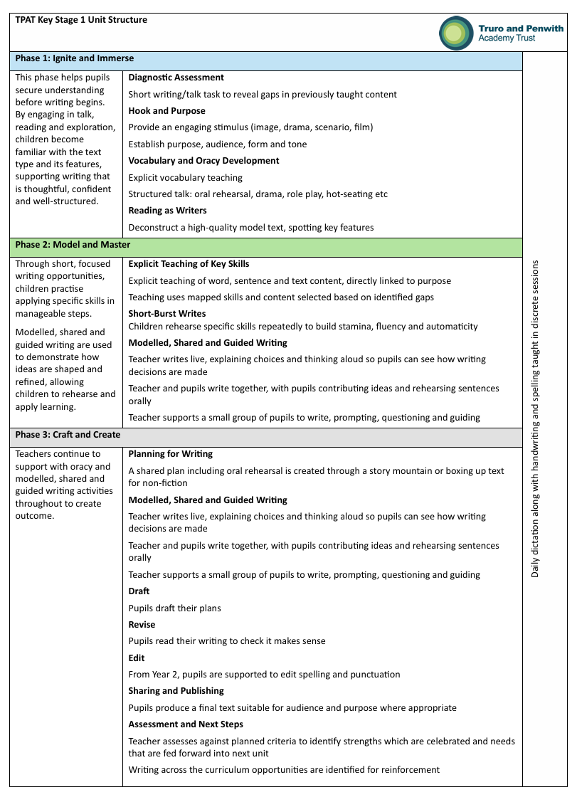
Key Stage 1 Unit Structure

Slide 11
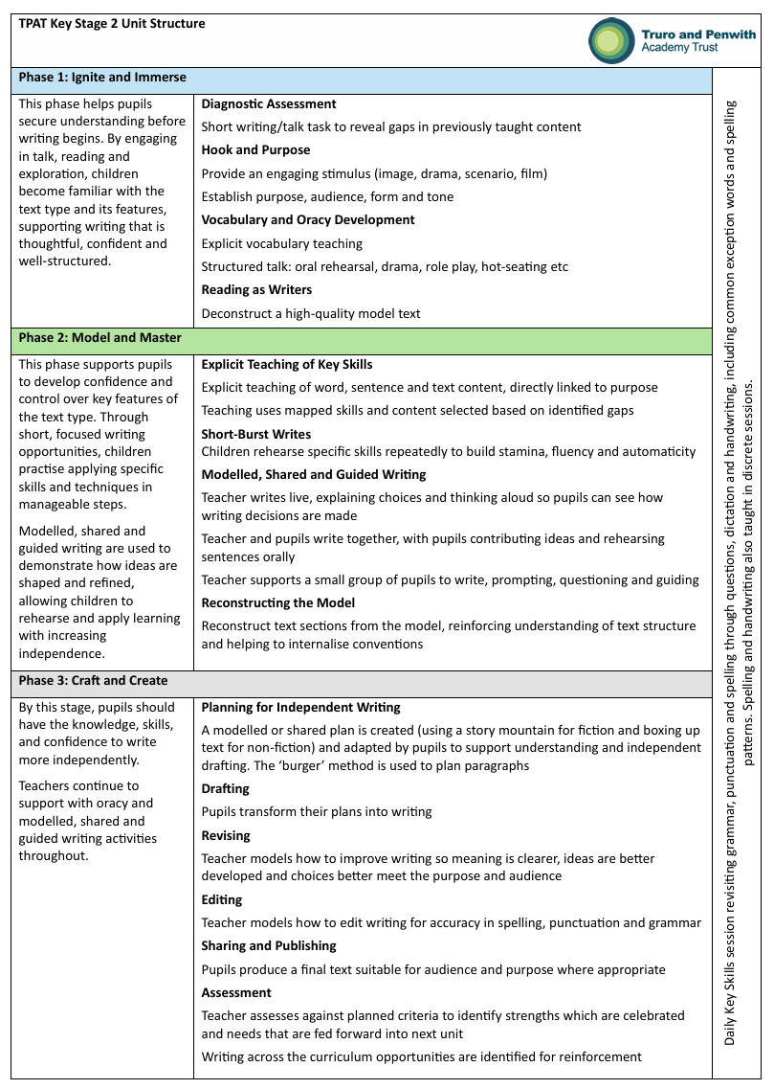
Key Stage 2 Unit Structure

Slide 12
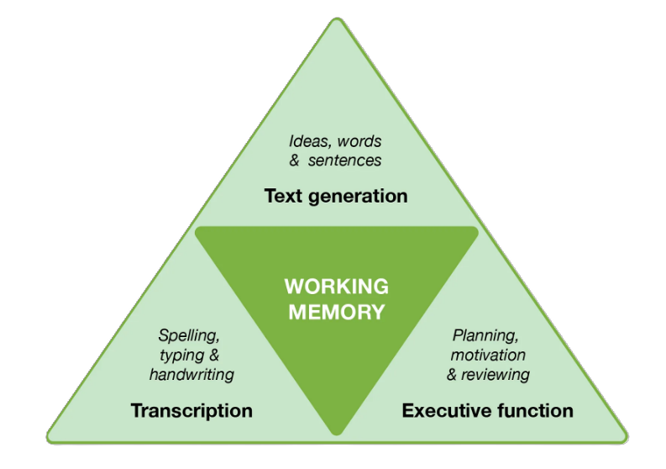
Key Stage 1 – Daily Dictation
Daily dictation starts when pupils have completed RWI Get Writing or the TPAT programme written to sit alongside Little Wandle. Sentences have been planned for Year 2, which may be used.
Why do we use dictation?
Writing places a significant demand on working memory. Pupils have to hold in mind what they want to say, how to say it and how to write it. In the Simple view of Writing, these elements sit alongside each other, with working memory at the centre coordinating them all. If transcription is not automatic, working memory becomes overloaded and pupils struggle to write effectively.
Dictation supports this by reducing the load on working memory and strengthening transcription, so that spelling and handwriting become more automatic and pupils can focus more on composition.
Dictation helps pupils:
  Build automaticity in spelling and handwriting
  Reduce cognitive load so they can focus on ideas
  Strengthen application of phonics
  Support sentence construction
  Receive immediate feedback through live marking
How does dictation work?
1. Say the whole sentence - Teacher says and repeats the sentence. Pupils listen and repeat aloud. This secures understanding and reduces working memory load.
2. Rehearse and count the words - Pupils repeat the sentence and count the words. This develops awareness of word boundaries and breaks the task into chunks.
3. Model the sentence - Teacher writes the sentence, thinking aloud about spelling, segmenting, handwriting and punctuation.
4. Remove the model - Teacher hides the sentence. Pupils prepare to write from memory. This encourages retrieval rather than copying.
5. Pupils write independently - Pupils write the sentence. Teacher circulates and gives immediate feedback. This provides purposeful practice and supports accuracy.

Slide 13
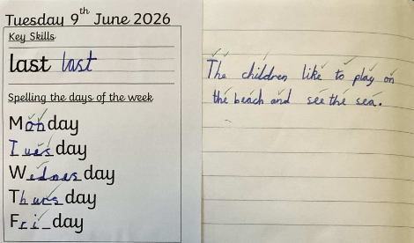
Key Stage 1 – Daily Dictation
Key principles to remember
  Dictation is practice, not assessment
  Working memory is supported by reducing transcription demands
  Sentences must match taught phonics
  Focus on accuracy and fluency, not speed
  Immediate feedback is essential
  Keep sessions short, focused and daily
Dictation helps pupils move from struggling to remember how to write to being able to think about what to write.
Tackling Transcription Using Sentence Dictation - Research School's Network

Slide 14
Key Stage 2 Key Skills
Why do we have a daily Key Skills session?
Writing is a complex process that places significant demands on working memory. Pupils must hold in mind what they want to say, how to structure sentences, and how to spell and form words accurately. If transcription and sentence knowledge are not secure, pupils can become overloaded and struggle to write effectively.
The Writing Framework (2025) highlights that transcription needs to become automatic through practice so that pupils can focus on composition. Similarly, research shows that when pupils develop fluency in transcription, they are better able to develop, organise and communicate their ideas.
This is why daily practice is essential. The Key Skills session sits alongside writing lessons and focuses on short, regular practice of grammar, punctuation and transcription skills to support pupils in developing accuracy and fluency.
Writing lessons apply skills through extended composition, focusing on purpose, audience and structure. Key Skills sessions practise, revise and secure key knowledge so it becomes automatic.
Why daily practice matters:
  Frequent retrieval strengthens memory and supports long-term learning
  Practice builds automaticity in spelling, grammar and punctuation
  Reduces cognitive load during writing lessons
  Allows quick identification and response to misconceptions
Key Skills Overview
Our Key Skills sessions consist of grammar and punctuation practice through SATs-style questions, with one clear focus per week.
• Autumn 1 — Revisiting the Foundations
• Autumn 2 — Building Sentence Structure
• Spring 1 — Word Class and Punctuation
• Spring 2 — Word-Level Knowledge and Sentence Accuracy
• Summer 1 — Applying and Extending
• Summer 2 — Consolidation and Mastery

Slide 15
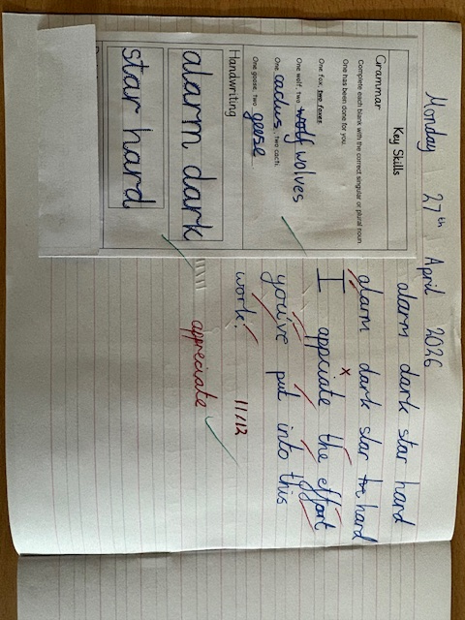
Key Stage 2 Key Skills
Daily Dictation
Daily dictation is also part of this session and includes key spelling patterns and common exception words, punctuation and grammar content.
Three sentences are planned for each week:
  • One new sentence
  • Two sentences revisited for review
  • Opportunities to assess and respond to misconceptions
Key Principles for Staff
  • This is daily practice, not assessment
  • Focus on accuracy and thinking, not speed
  • Ensure explicit modelling and feedback
  • Keep sessions short, focused and consistent
Daily Key Skills sessions ensure pupils revisit, practise and automatise the building blocks of writing, supporting fluency and success in extended writing.

Slide 16
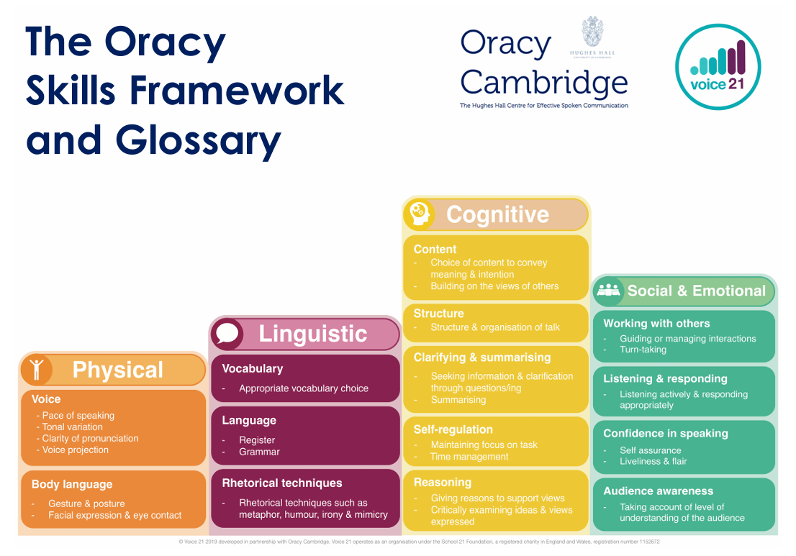
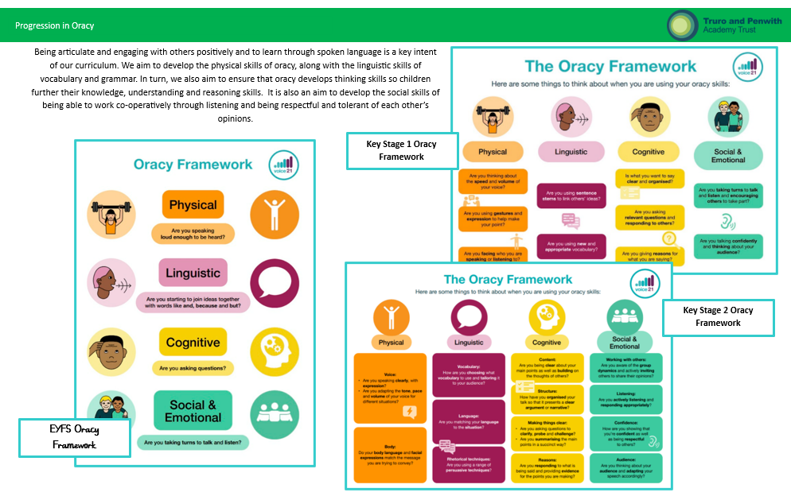
Progression in Oracy
Developing articulate, confident speakers who engage positively with others is a key intent of the TPAT writing curriculum. We prioritise the explicit teaching of oracy through a progressive approach that builds the physical skills of speaking, alongside the linguistic skills of vocabulary choice and grammatical accuracy. Through structured opportunities for talk, children refine their ability to express ideas clearly and purposefully.
Oracy is also central to thinking. We use talk to deepen knowledge, strengthen understanding, and develop reasoning, enabling children to rehearse, shape and extend their ideas before writing. Alongside this, we foster the social aspects of oracy, ensuring pupils learn to listen attentively, collaborate effectively, and respond respectfully and thoughtfully to the views of others.

Slide 17
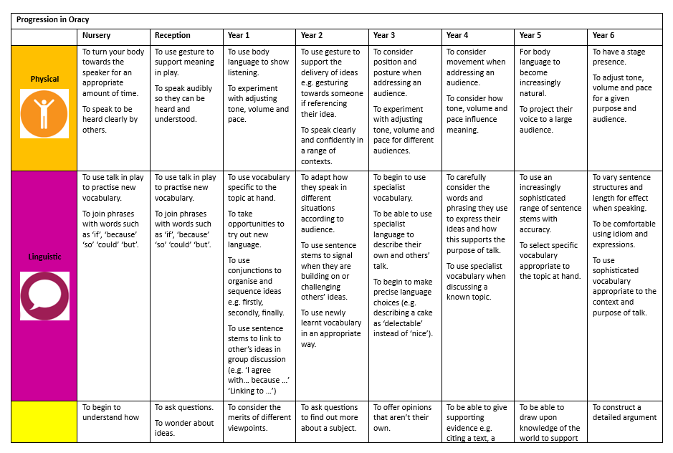
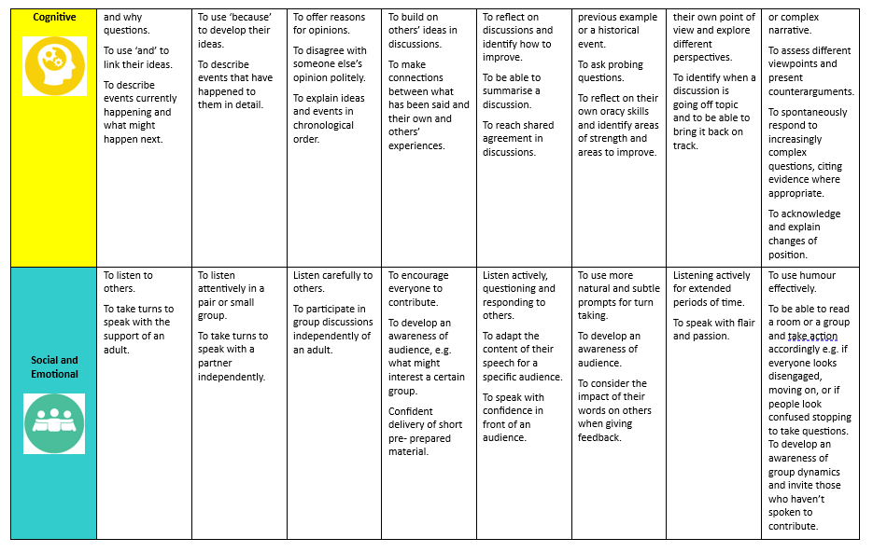
Progression in Oracy

Slide 18






Handwriting
Handwriting is taught discretely, in a daily 10 to 15 minute session, to ensure pupils develop fluent, legible and automatic transcription skills, in line with the DfE Writing Framework (2025). Writing is cognitively demanding, requiring pupils to manage letter formation, spelling and composition simultaneously. The framework emphasises that handwriting should be explicitly taught from Reception and practised regularly so that it becomes automatic, freeing up working memory for sentence construction and idea development. A structured approach to handwriting, including the explicit teaching of letter formation, joins and posture, enables pupils to build fluency and write efficiently and with confidence across the curriculum.
Handwriting is taught discretely because it is a physical and motor-based skill, distinct from the linguistic knowledge required for spelling. When it is not secure, pupils’ cognitive effort is focused on letter formation, limiting their ability to focus on to spelling, sentence structure and composition.
Research shows that improving handwriting fluency has a direct impact on overall writing fluency, reinforcing the importance of regular, focused practice. Teaching handwriting separately ensures pupils develop the physical automaticity needed for clear, fluent and effective written communication.
Chosen Trust Schemes
https://global.oup.com/education/content/primary/series/nelson-primary/nelson-handwriting-3ed/?region=uk
https://www.kineticletters.com/
https://www.letterjoin.co.uk/index.html
https://www.cambridge.org/gb/education/subject/english/literacy/penpals-handwriting-2nd-edition
https://www.ruthmiskin.com/handwriting/
https://www.littlewandle.org.uk/

Slide 19


Spelling
Spelling is taught discretely, in a 10 to 15 minute sessions, to ensure pupils develop secure and automatic transcription skills, in line with the DfE Writing Framework (2025).
Writing places significant demands on pupils’ working memory, as they must coordinate spelling, handwriting and composition simultaneously.
Discrete spelling teaching allows for systematic, sequenced instruction in phonics, orthography (how words are written e.g. spelling patterns) and morphology (how words are built e.g. roots, prefixes, suffixes), ensuring that key patterns are revisited and embedded over time, rather than relying on incidental learning through writing alone.
Spelling is taught separately from handwriting because, although both are elements of transcription, they involve different types of knowledge and development. Evidence suggests that handwriting fluency often stabilises earlier, whereas spelling continues to develop throughout the primary years, further reinforcing the need for focused, discrete instruction
Chosen Trust Schemes
https://www.spellingshed.com/en-gb
https://www.ruthmiskin.com/spelling/
(When phonics is completed)
https://emile-education.com/
https://www.littlewandle.org.uk/
(Year 2)

Slide 20
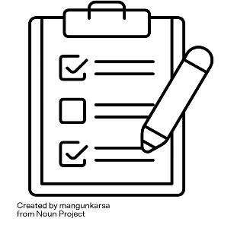
Ignite and Immerse
Diagnostic Assessment
Why?
We begin each writing unit with a diagnostic task to establish pupils’ starting points. This allows teachers to identify what pupils can remember from previous learning that feeds directly into the unit ahead and can be applied independently. It also highlights common misconceptions and supports teachers in grouping pupils and planning targeted support. This ensures that teaching is responsive, appropriately pitched and built on prior learning.
How?
A diagnostic task does not always involve extended writing. In Key Stage 1, this may include oracy activities, picture discussion, sequencing, short dictation or simple sentence writing to assess phonics, transcription and early composition.
In Key Stage 2, diagnostics may include structured talk, dictation, test‑base questions or a brief written piece to assess spelling, punctuation, sentence construction, language choices and understanding of text types. In all cases, the focus is on independent application rather than supported performance.
Any gaps identified that are essential for success in the text are explicitly woven into the teaching sequence, ensuring key knowledge and skills are revisited and secured before moving forward.

Slide 21
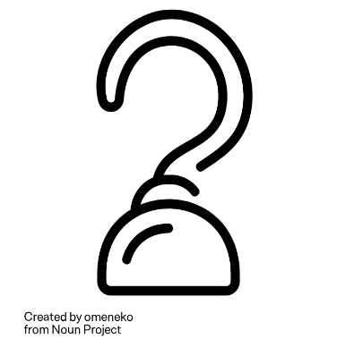
Ignite and Immerse
Hook
Why?
We begin each writing unit with a carefully chosen hook to spark curiosity, emotional connection and motivation. A strong hook helps pupils engage and encourages enjoyment, confidence and a positive attitude towards writing. It also provides a clear purpose and audience for writing, helping pupils understand why their writing matters.
How?
In Key Stage 1, hooks are immersive, often using a high‑quality text, image, photograph, object, role‑play scenario or short film clip to inspire talk, imagination and vocabulary. These experiences help pupils connect meaningfully with the writing before they are asked to record ideas.
In Key Stage 2, hooks may be more sophisticated and varied, such as a powerful text extract, image, film clip, real‑life scenario, visit or stimulus photograph. These hooks are designed to provoke discussion, deepen understanding of context and genre and build engagement. Where appropriate, hooks are revisited throughout the unit to maintain purpose and support pupils in shaping their final outcome.

Slide 22


Ignite and Immerse
Purpose and Audience
Why?
The Writing Framework (2025) makes clear that effective writing depends on pupils having a clear purpose for writing and an awareness of the intended audience. Explicitly teaching purpose and audience helps pupils understand why they are writing, who their writing is for and how this should shape language choices, content and tone. It also supports pupils in making deliberate authorial choices, enabling them to communicate meaning clearly and effectively rather than writing purely for task completion.
How?
In Key Stage 1, purpose and audience are introduced through familiar, meaningful contexts of writing to entertain or inform, with audiences that are real or relatable, such as friends, teachers or story characters, helping pupils to begin writing with a clear reason and a simple awareness of who will read their writing.
In Key Stage 2, pupils are taught to make more deliberate choices based on purpose and audience by considering how writing to entertain, inform, discuss or persuade a wider or unknown audience should shape structure, vocabulary and tone. Pupils are supported to adapt their writing accordingly, selecting appropriate language, form and level of formality to suit the reader.

Slide 23
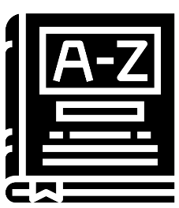
Ignite and Immerse
Vocabulary Development
Why?
Vocabulary is central to effective writing. Pupils need a secure understanding of words in order to construct sentences that convey meaning clearly and precisely.
The Writing Framework (2025) emphasises that vocabulary sits alongside grammar and sentence construction as part of composition. It highlights that while knowledge of grammar and vocabulary is important, these elements do not improve writing fluency when taught in isolation, they must be applied meaningfully within writing.
EEF guidance further highlights that vocabulary is developed through
explicit teaching
repeated exposure
opportunities to use new words in different contexts
How?
Vocabulary is explicitly taught before being interwoven throughout the unit, with a deliberate emphasis on Tier 2 vocabulary. Tier 3 vocabulary is introduced more selectively and is most commonly taught within non‑fiction units where subject‑specific language is required.
Teachers identify and pre‑teach key vocabulary from the model text, explain meanings in child‑friendly language and model how words are used purposefully within sentences. Pupils rehearse new vocabulary through discussion, role‑play, vocabulary cards, Frayer models, sentence‑level activities and oral rehearsal, as well as through quick‑fire games, partner talk, visual prompts, word banks and sentence stems, before applying it in their own writing.
Vocabulary is displayed in the classroom to support recall and spelling. Planned opportunities for revisiting and deliberate practice ensure vocabulary is retained over time and transferred into independent writing.
In Key Stage 1, vocabulary development is rooted in talk, reading and shared experiences. Vocabulary is revisited regularly and applied through oracy and sentence‑level work.
In Key Stage 2, vocabulary instruction becomes increasingly explicit and purposeful. Pupils explore words in different contexts, compare meanings and consider shades of meaning and connotation so they can make deliberate, precise language choices as writers.

Slide 24
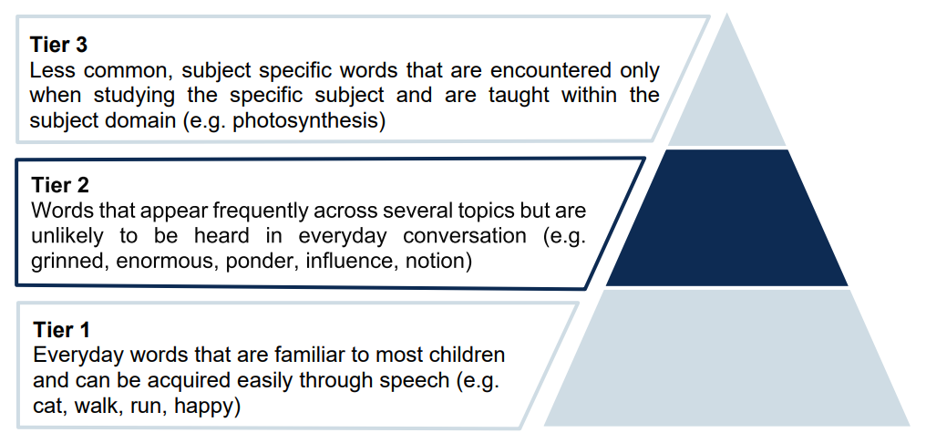
Ignite and Immerse
Vocabulary Development continued
Department for Education (DfE) (2025) The Writing Framework

Slide 25
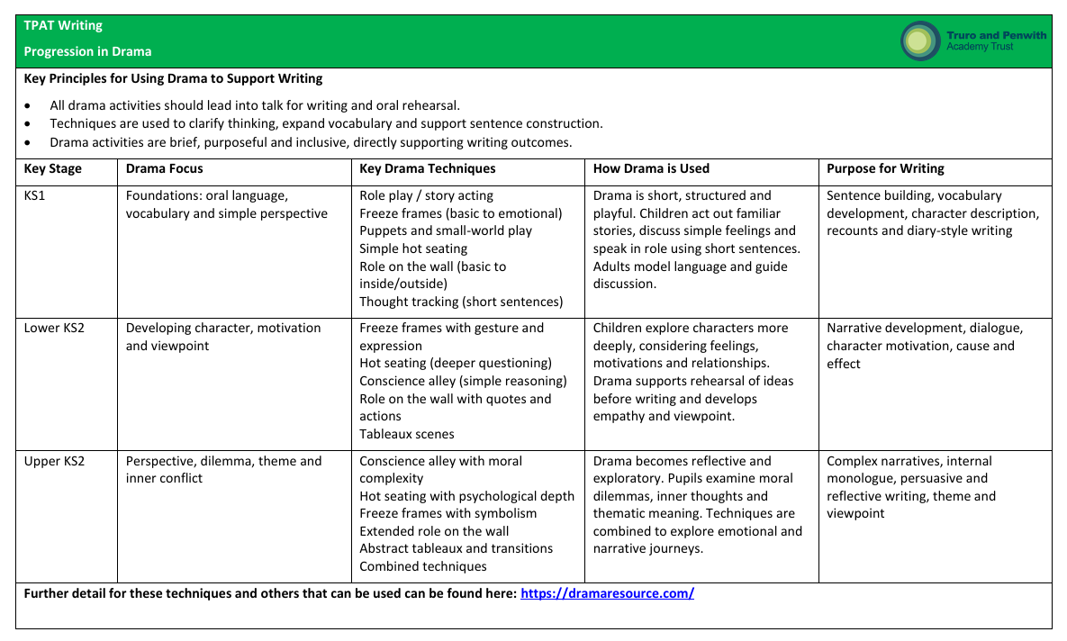
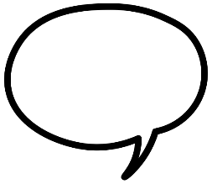
Ignite and Immerse
Structured Talk and Drama
Why?
Effective writing depends on pupils having clear ideas and purposeful language before they begin to write. Talk is a critical foundation for composition because it helps pupils develop and organise ideas, rehearse vocabulary and sentence structures and understand purpose and audience. It also supports pupils in refining and extending their thinking before transcription, reducing cognitive load when writing.
Drama and structured talk provide shared experiences that deepen understanding and engagement, particularly for pupils who need additional language support, ensuring that writing is meaningful and rooted in secure thinking rather than starting from a blank page. These approaches enable pupils to orally rehearse sentences and language choices before applying them in writing.
How?
Structured talk and drama are planned deliberately as part of the first phase of writing and are always selected because they prepare pupils for the specific writing outcome. Drama techniques are used to explore content, viewpoint and language that pupils will later draw on in their writing. Teachers model high-quality spoken sentences and vocabulary, supporting pupils to rehearse and refine ideas before writing. Talk is scaffolded, modelled and concluded with reflection so that pupils explicitly connect what they have said to what they will write, ensuring that talk supports composition and is never a standalone activity.
https://dramaresource.com/

Slide 26

Ignite and Immerse
Reading as Writers
Why?
Reading as writers is taught so that pupils learn how writing is constructed. By noticing how authors make deliberate choices, pupils understand that writing is purposeful and shaped to achieve an intended effect for a reader. This supports pupils in internalising effective structures and language so they can draw on these independently in their own writing.
Through reading as writers, pupils explore how texts are structured, how language is used at word and sentence level and how ideas are organised and developed. This supports pupils to build a growing repertoire of patterns, features and strategies that they can draw upon in their own writing. Over time, this moves pupils from imitation towards increasingly independent and original composition.
How?
Teachers guide pupils through a model text, supporting them to find key features of the text type and relating this to the purpose and audience. Children might identify features orally through partner talk or through written methods such as highlighting. Teachers model thinking aloud to make authorial decisions explicit and link reading directly to writing outcomes.
In Key Stage 1, reading as writers focuses on noticing and talking about simple features of texts, such as repeated phrases, descriptive words, sentence patterns and story structure. Through shared reading and discussion of high‑quality texts, pupils explore what authors do and why, helping them to imitate language and structures in their own writing.
In Key Stage 2, pupils read more analytically as writers, exploring how authors adapt language, structure and tone for different purposes and audiences. They discuss authorial choices, identify features of specific genres and consider the effect these choices have on the reader. This supports pupils in making increasingly deliberate and controlled decisions in their own writing. Pupils are encouraged to apply, adapt and refine these features within their own writing, rather than simply replicate them.

Slide 27
Ignite and Immerse
Model Texts
Why?
We use high‑quality mentor texts, model texts and WAGOLLs so pupils can see what effective writing looks like before they write themselves. Well‑chosen and crafted models help pupils understand how purpose, audience, structure and language choices work together, creating a shared understanding of success and raising expectations for writing. They also reduce cognitive load by making the features of effective writing explicit and accessible to all pupils.
A mentor text is a high‑quality example used to study how authors shape and craft writing.
A teacher‑written model is a deliberately crafted example written to match the specific context, purpose and needs of the class.
A WAGOLL is a clear, accessible example that demonstrates the expected standard for a particular outcome.
Model texts can be carefully selected and are most effectively teacher-written to closely match the intended purpose, audience and outcome, include all features being explicitly taught alongside previously taught ones and are written at a level that is achievable and will motivate and support all pupils. This ensures pupils can internalise structures and language before applying them independently.
In Key Stage 1, pupils engage with high‑quality published texts and clear teacher‑written models that support talk, vocabulary development and understanding of basic text structures. These models are accessible and focused, enabling pupils to notice patterns, imitate language and revisit previously taught features with confidence.
In Key Stage 2, pupils work with a wider range of mentor texts, extracts and teacher‑written models that accurately reflect the demands of the planned final outcome. Teachers guide pupils to analyse how vocabulary, sentence structure, organisation and tone are shaped by purpose and audience, while revisiting prior learning to strengthen fluency and control.
WAGOLLs are used to clarify expectations and exemplify high‑quality outcomes. Where appropriate, AI may support the drafting or adaptation of teacher‑written models, allowing examples to be precisely matched to the purpose, audience and success criteria. These models support pupils in moving from imitation towards independence, making increasingly deliberate choices in their own writing.
All models are reviewed and refined by the teacher to ensure quality, accuracy and suitability for pupils.

Slide 28
Ignite and Immerse
Selecting Model Texts continued
AI can be used to support writing by generating high‑quality model examples that show clear structure, ambitious vocabulary and age‑appropriate sentence construction. These models should always be reviewed and adapted by the teacher to ensure they are accurate, appropriate and aligned with the intended learning.
As a general guide, complete pieces of writing might be around 20–30 words in Year 1, 50–80 words in Years 2–3, 100–150 words in Years 4–5, and 200–250 words in Year 6, with expectations increasing gradually as pupils develop stamina and independence.
Generating Model Texts via AI
Please create a [word count] word [text type] suitable for Year [year group] pupils in a UK primary school
Layout it out with: [list of layout features e.g. story structure or non-fiction structure].
Structure the paragraphs like this [structural features of paragraphs]
Include the following grammatical features: [list of grammatical features]
Additionally, include some of these words: [list of subject/topic specific words and spelling]
If you are asking AI to generate a narrative or character/setting description, you will need to specify the genre and author that you require the modelled text to be styled on and will need to give detail on the character’s personalities and settings.
Generated texts should align with prior learning, current teaching focus and intended outcomes, ensuring they remain accessible and achievable for all pupils.

Slide 29

Model and Master
Explicit Teaching of Skills
Why?
When pupils learn grammar or sentence structures incidentally, they may be able to identify a feature but struggle to use it effectively in their own writing. New word, sentence and text‑level content therefore must be explicitly taught, so pupils are not left to guess what they are learning or why it matters. Explicit teaching makes expectations clear and ensures all pupils have equitable access to the knowledge required for successful writing.
Linking this explicitly-taught content directly to a specific writing outcome ensures that each concept is introduced with a clear purpose and an immediate application. This approach helps pupils understand why particular choices are taught and when they should be used. As a result, pupils are more likely to retain this learning and apply it independently in future writing. It also supports pupils in moving from identification to deliberate and controlled use within their own writing.
How?
Explicit teaching of the planned word, sentence and text‑level content is the central focus at this stage. This includes new content identified through curriculum planning, as well as aspects identified through diagnostic assessment as needing further development. Teachers model these skills deliberately and clearly within meaningful writing contexts linked to the intended outcome.
Practice at word and sentence level, short writing tasks and shared pieces are not treated as isolated exercises. Instead, they are tightly aligned to the final piece of writing, so pupils understand how each word, sentence or text‑level decision contributes to the overall effect. These examples are revisited, adapted and reused later in the unit and in subsequent writing. This repeated, purposeful practice supports retention and transfer into independent writing.
Teaching follows a structured modelled, shared and guided approach (‘I do, we do, you do’), with metacognitive talk accompanying modelling so pupils understand how writers think and make decisions. This supports pupils in making clearer, more intentional choices in their own writing and enables their work to be improved more effectively.
Strong examples, practice sentences and shared pieces are added to the working wall so pupils can draw on them during independent writing. These are actively referred to and used, rather than simply displayed, to support pupils in applying taught skills with increasing independence.

Slide 30

Model and Master
Short-Burst Writes
Why?
Short‑burst writing is used so pupils can secure sentence construction before being expected to produce extended pieces of writing. This gives pupils frequent and focused opportunities to practise forming accurate, effective sentences without the additional demands of planning, structuring and sustaining longer texts. This ensures pupils develop control and confidence at sentence level before increasing the complexity of writing tasks.
Short‑burst writing is underpinned by oral composition before written output, allowing pupils to rehearse ideas and sentence structures aloud. This reduces cognitive load and supports pupils to write with greater accuracy and confidence when they later apply these skills in longer pieces of writing.
By mastering sentences first, pupils are better prepared to sustain quality and control when they move on to extended outcomes. It also supports pupils in writing with greater fluency, as sentence construction becomes increasingly automatic.
How?
Short‑burst writing focuses on the explicit and planned practice of vocabulary, grammatical features and sentence structures that are directly linked to current and future writing outcomes.
In Key Stage 1, pupils engage in focused activities that support them to apply explicitly taught vocabulary and sentence structures purposefully. Activities are carefully chosen to strengthen sentence construction within meaningful contexts. These activities support pupils to rehearse, refine and internalise sentence patterns before applying them independently.
In Key Stage 2, pupils work with a wider and more complex range of vocabulary and grammatical features. Short‑burst writing supports pupils to master applying these features within sentences and cohesive strings of sentences. This helps pupils begin to link sentences effectively and develop control over cohesion.
Across both key stages, short‑burst writing tasks are explicitly linked to the final writing outcome. Sentences and short pieces created during this phase are not treated as disposable practice; instead, they are revisited, adapted and drawn upon later to support pupils in producing extended writing with greater control and fluency. This reinforces the transfer of skills from practice into independent writing.

Slide 31

Model and Master
Modelled Writing (I do)
Why?
Pupils learn to write effectively by observing expert writers, with the teacher taking the lead as the expert writer while pupils observe. Through modelled writing, the teacher demonstrates how to apply new knowledge in small, manageable steps. This breaks down the writing process and makes complex thinking accessible to all pupils. By thinking aloud, the teacher makes the invisible processes of writing visible, drawing attention to decisions about language, structure, audience and purpose. This supports pupils to understand how writers solve problems, make deliberate choices and construct texts that communicate meaning clearly for a specific reader. Over time, this helps pupils internalise these processes and apply them independently.
How?
In Key Stage 1, teachers model writing sentences, explicitly verbalising choices about words, spelling and sentence construction. Teachers generate and rehearse words and short phrases collaboratively with pupils before modelling them in writing. Pupils watch, listen and discuss the teacher’s decisions, helping them understand how ideas and orally rehearsed language are shaped into written sentences.
In Key Stage 2, teachers model more complex sentence writing, explaining and justifying choices around vocabulary, sentence structure, organisation, audience and purpose. Teachers generate word choices and phrases with pupils, refining language together before modelling how it is used effectively in context. Pupils are supported to analyse how the model achieves its intended purpose, enabling them to apply these strategies independently in their own writing.
Across both key stages, modelling is carefully linked to the final writing outcome and revisited throughout the unit. Teachers gradually release responsibility, moving from demonstration to supported practice, so pupils develop confidence and control in applying these skills independently.

Slide 32
Model and Master
Shared Writing (We do)
Why?
Shared writing is used to bridge the gap between modelled writing and independent writing. It enables pupils to apply newly taught skills with teacher support, ensuring they can practise making decisions while still being guided. This supports pupils in moving from observation to active participation in the writing process.
Through shared writing, pupils contribute ideas while the teacher guides and shapes the writing, drawing attention to key decisions about vocabulary, sentence structure, organisation, audience and purpose. Metacognitive talk is used throughout to make thinking explicit, helping pupils understand not just what to write, but why particular choices are made. This allows pupils to rehearse and apply learning in a supported context, strengthening understanding and building confidence before independent writing.
Shared writing helps pupils refine their ideas, clarify thinking and develop control over writing, ensuring that learning is secure and transferable.
How?
In Key Stage 1, shared writing focuses on constructing sentences collaboratively. Teachers guide pupils in selecting words, forming sentences and applying phonics, spelling and simple sentence structures. Pupils contribute ideas orally, which are shaped and refined by the teacher into written sentences, reinforcing the connection between spoken and written language. Teachers use simple metacognitive talk to explain choices, for example why one word is more effective than another or how a sentence could be improved.
In Key Stage 2, shared writing extends to longer sequences of sentences, paragraphs and whole-text construction. Teachers support pupils in making decisions about vocabulary, sentence structure, organisation, cohesion, audience and purpose. Pupils contribute and discuss ideas, while the teacher guides, challenges and refines responses to ensure accuracy and effectiveness. Metacognitive talk is used to model the decision-making process explicitly, including evaluating choices, refining language and considering the impact on the reader.
Across both key stages, shared writing is carefully linked to the final writing outcome and follows a structured approach, moving from high levels of support to increasing independence. Teachers provide immediate feedback, address misconceptions and model refinement so pupils learn how writing can be improved in real time. This ongoing dialogue helps pupils internalise effective strategies and apply them independently in their own writing.

Slide 33
Model and Master
Guided Writing
Why?
Guided writing involves the teacher working with a selected groups of pupils and gives them the structured support they need to develop confidence, independence and control over their writing. Through a focused shared learning experience, children can discuss choices, ask questions and learn from one another to strengthen their understanding of how writing works whilst the teacher has close oversight to monitor focus and address misconceptions. This targeted support ensures pupils can secure key skills and apply them with greater accuracy. Over time, guided writing helps learners internalise these strategies so they can apply them independently, making it a powerful bridge between teacher-led instruction and confident, autonomous writing. Metacognitive talk is used to make thinking explicit, helping pupils understand how and why writing decisions are made.
How?
Teachers explicitly model thinking processes in a small focus group whilst the rest of the class writes independently. As a group, the teacher and pupils will collaboratively construct one or more sentences that focus on one key skill. This may have an explicit transcription focus, or may develop composition skills, such as organising ideas, selecting vocabulary or applying grammar effectively in context.
Teachers adjust and adapt teaching within these guided groups to explicitly target those that might fall behind. They provide timely, targeted feedback to pupils which over time, develops their transcription and composition skills effectively. Support is carefully scaffolded and gradually reduced so pupils take increasing responsibility for their writing and apply these skills more independently.

Slide 34

Model and Master
Reconstructing the Text
Why?
Reconstructing the text is used so pupils can practise applying newly taught word, sentence and text‑level skills before being expected to write independently. It allows pupils to focus on how writing works, without the full cognitive demands of generating ideas, organising content and sustaining longer pieces of writing. This supports pupils in developing control over key writing features within a supported structure.
By reconstructing a text, pupils strengthen their understanding of structure, sentence construction and vocabulary choices. This deepens learning and supports retention, making pupils more likely to apply these skills accurately and confidently in later independent writing.
Reconstructing the text supports pupils to move from noticing and understanding key features to using them deliberately for themselves. It forms a bridge between guided practice and independent composition.
How?
In Key Stage 2, reconstructing the text takes place after explicit teaching. We guide pupils to rebuild all or part of a model text using the explicitly taught features. This may be done orally, through shared or guided writing or through short written tasks.
Support is gradually reduced so pupils begin to make independent decisions while still working within a clear structure. Tasks are carefully designed so pupils must apply:
  Punctuation
  Taught vocabulary
  Sentence structures and grammatical features
  Organisational or cohesive elements
This ensures pupils apply skills in combination, rather than in isolation.
The reconstructed text remains closely linked to the final writing outcome. Sentences and sections created during reconstruction are revisited, adapted and built upon later in the unit, helping pupils understand how early practice contributes directly to extended writing. This strengthens transfer from supported practice to independent writing.
Teaching follows a modelled, shared and guided approach, with clear metacognitive talk to make the decision‑making process explicit. Regular feedback helps pupils refine their choices and strengthens their ability to apply these skills more independently over time.

Slide 35
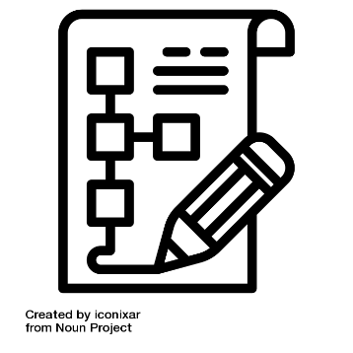
Craft and Create
Planning
Why?
Planning is taught so pupils can organise and shape their ideas purposefully, rather than attempting to plan and write at the same time. When planning is not explicitly taught, pupils may know what they want to say but struggle to organise ideas clearly, sustain meaning or write coherently. Explicit planning reduces cognitive load and supports pupils to focus on composition more effectively when writing.
Effective planning helps pupils understand how ideas are grouped, sequenced and developed to meet a specific purpose and audience. It also supports pupils in making deliberate choices about content and structure before writing begins.
How?
Planning is taught explicitly and briefly, following direct instruction in the relevant word, sentence and text‑level content. This ensures pupils are prepared to organise ideas without being overloaded or expected to manage multiple aspects of writing at once.
Teachers model how writers plan by verbalising decisions about content, organisation and sequencing, always linking planning choices to the intended outcome, purpose and audience. Planning is structured and scaffolded, with the focus on organising ideas rather than drafting sentences in full. Clear frameworks, prompts or models are provided so pupils learn how to map out ideas without being diverted into unnecessary transcription.
Pupils practise planning through modelled, shared and guided activities before planning independently. Oral rehearsal is used throughout so pupils can articulate ideas and structure them before recording them in note form. Expectations for planning are proportionate and purposeful, supporting pupils to move confidently into writing.
Planning is not treated as an end in itself. Plans are used immediately to support writing and are referred back to as pupils draft, revise and improve their work, reinforcing the connection between planning decisions and the final written outcome. This ensures planning directly supports the quality and coherence of the final piece.
In Key Stage 1, planning is lightweight and scaffolded. Pupils may organise ideas visually, for example by sequencing images from a familiar story or photographs from a shared experience. Key words and simple ideas may also be identified to support drafting before writing each sentence.

Slide 36

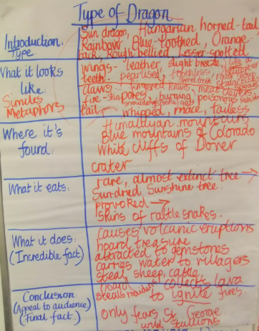
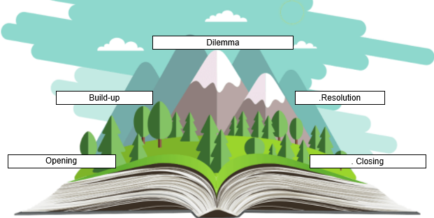
Craft and Create
Planning continued
In Key Stage 2, planning is supported through simple, memorable, whole‑school planning models that help pupils build a clear mental understanding of different text structures. These models support pupils to organise ideas effectively and reduce the cognitive demands of composition.
As pupils’ writing develops, planning models may become more sophisticated; however, the underlying structure remains consistent so pupils can rely on them with confidence. Pupils should be able to refer to their planning model during drafting to support organisation and coherence.
When planning longer pieces, pupils organise ideas through clearly defined text planning formats: story mountains for narrative writing, boxing‑up grids and other genre‑based structures.
An effective planning model:
makes clear where paragraphs will be placed and the single idea each paragraph develops
captures key vocabulary and language features required for the text
reflects a clear understanding of purpose and audience
remains accessible to pupils while they are writing

Slide 37
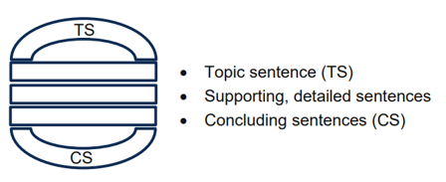
Craft and Create
Planning continued
Planning paragraphs
In Key Stage 1, the focus is on securing sentence structure and recording ideas in accurate sentences.
In Key Stage 2, once pupils can write secure sentences, paragraphs can be planned and developed more deliberately, with each paragraph focused on a single, clear idea. Sentence combining supports pupils to understand how sentences link and build cohesion across a paragraph. A consistent, whole‑school paragraph visual model enables pupils to apply and refine paragraph structure confidently and independently.
The ‘Burger’ method is used for this:
Department for Education (DfE) (2025) The Writing Framework
Sedita, J (2023) The Writing Rope

Slide 38

Craft and Create
Drafting (I do)
Why?
Drafting is the stage where pupils turn their ideas and plans into writing. If pupils are expected to think about too many things at once, such as ideas, structure, sentence choice, spelling, punctuation and handwriting, the quality of writing can be affected. All these elements are important, but the main focus during drafting is on shaping and communicating ideas clearly and coherently. Accuracy is addressed more fully once ideas have been developed through drafting. This ensures pupils can maintain focus on meaning and coherence without becoming overloaded.
How?
In Key Stage 1, pupils are supported to compose sentences orally before writing them down. This helps pupils focus on meaning and sentence structure before recording their ideas in writing. Teachers model and scaffold this process so pupils understand how to move from spoken to written language.
In Key Stage 2, pupils are taught to draft coherently in paragraphs and to sustain longer pieces of writing. Teachers use scaffolds and planned stopping points so pupils can pause, reflect on progress and stay focused on their writing goals. Throughout drafting, pupils are encouraged to refer back to their plans and models so writing remains organised and purposeful. Metacognitive talk is used to support pupils in reflecting on their choices and making purposeful adjustments as they write.

Slide 39

Craft and Create
Revising
Why?
Revising supports pupils to improve their writing so it better meets the intended purpose and audience. Through revising, pupils learn that writing is refined over time and that first drafts are rarely finished pieces.
Revising allows pupils to develop ideas more fully, improve clarity and make deliberate choices, such as adding detail, combining sentences or improving cohesion. This stage helps pupils understand that writing can be improved through re‑reading, reflection and feedback, rather than being correct on the first attempt.
How?
Revising is introduced through teacher‑led and scaffolded modelling, showing pupils how writers return to their work and make purposeful improvements. Over time, pupils are supported to take increasing responsibility for revising their own writing.
In Key Stage 1, pupils are supported to make small, manageable revisions, such as adding a word, improving a sentence or checking that their writing makes sense when re‑read. Revising at this stage is often brief and guided, as completing a first draft already requires significant effort.
In Key Stage 2, pupils are given opportunities to assess the effectiveness of their own and others’ writing and suggest improvements. Pupils are more likely to notice the need for cohesive devices when revising than when drafting, so this stage is given sufficient time and is not rushed. Tools such as checklists may be used to support this cognitively demanding process.
Across all stages, revising is supported through re‑reading, discussion and feedback, helping pupils understand how written work can be refined and improved over time. This process supports the development of independence, as pupils learn to identify and improve their own writing with increasing confidence and control.

Slide 40
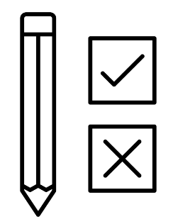
Craft and Create
Editing
Why?
Editing helps pupils identify and correct errors in spelling, punctuation and grammar so their writing is accurate and clear for the reader. Editing is a distinct stage from revising and focuses on correcting errors rather than improving content or ideas. This ensures pupils can focus specifically on accuracy without being distracted by the demands of composition.
Pupils need explicit support to learn how to edit effectively. Over time, editing develops pupils’ independence and helps them take responsibility for checking their own work. It also supports pupils in recognising patterns in errors and improving accuracy over time.
How?
In Reception and Year 1, pupils are not expected to edit their own writing. At this stage, adults model and support accuracy through feedback and re‑reading.
From Year 2, pupils are supported to edit their writing with guidance. This may involve reviewing work with the teacher, being prompted to identify spelling and punctuation errors, and using shared editing symbols that are applied consistently across the school.
In Key Stage 2, pupils are taught to proofread their work for spelling, grammar and punctuation with increasing independence. Editing the work of others is used to help pupils develop an awareness of writing for a reader and to practise identifying errors before applying this to their own writing.
Editing checklists may be used to support pupils in remembering what to check. These are used consistently and gradually reduced as pupils develop confidence and independence.

Slide 41

Craft and Create
Publishing
Why?
Sharing their writing helps pupils understand that writing is purposeful and created to be read or heard by an audience, where appropriate and meaningful. Knowing that their work will be shared supports motivation and helps pupils recognise the importance of clarity, effort and meaning.
Opportunities to share writing allows pupils to receive feedback and to see their work as valued. While sharing can be motivating, it may also feel daunting for some pupils, so expectations should be reasonable and supportive. Sharing is therefore carefully considered to ensure it enhances learning rather than creating unnecessary pressure.
How?
Sharing writing is approached flexibly and may involve formal publication, depending on the planned audience. Pupils are given appropriate opportunities to share completed work in ways that support confidence and purpose, where appropriate and meaningful.
In Key Stage 1, sharing is simple and supportive. This may include pupils reading their writing aloud to an adult or the class, sharing work with a partner or completing a final version knowing it will be read by the teacher. The focus is on building confidence and helping pupils understand that their writing communicates meaning to others.
In Key Stage 2, pupils share writing more widely and for a clearer audience. This may include sharing work with peers, another class, parents or carers, or producing writing for a real purpose where a response may be expected. More formal opportunities for publishing, such as blogs, letters or emails, are introduced where appropriate.
Across all stages, a consistent whole‑school approach to sharing and publishing writing helps create an environment where writing is valued, while ensuring that sharing enhances learning rather than reducing time spent developing writing skills.

Slide 42
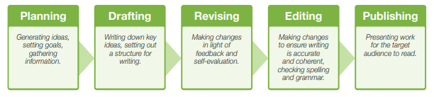
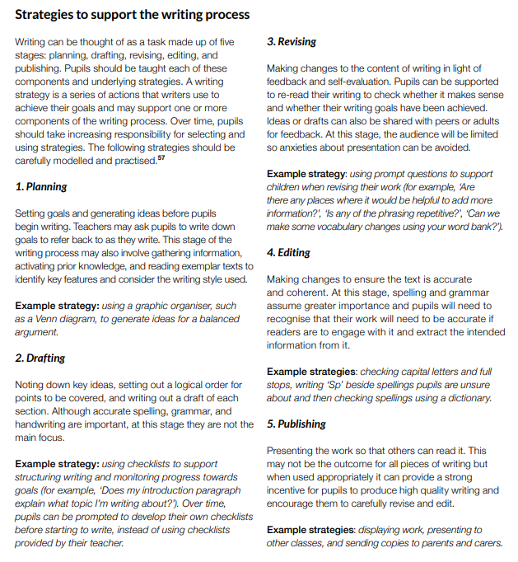
Craft and Create
Education Endowment Foundation (EEF) (2021) Improving literacy in Key Stage 2: Guidance report (2nd ed.)

Slide 43

Craft and Create
Assessment
Why?
Assessment is used to understand pupils’ progress in writing and to inform next steps in teaching. Ongoing formative assessment supports pupils during learning, while summative assessment provides a clear picture of progress over time. Assessment is continuous and informs every stage of the writing process, ensuring teaching is responsive and closely matched to pupils’ needs.
Assessment also helps identify pupils who need additional support and monitors pupils’ confidence and attitudes towards writing. It supports consistency in expectations and a shared understanding of standards across classes, schools and the wider trust.
How?
Most assessment of writing is formative and integrated into daily teaching. Teachers use observations, discussion, feedback, peer review and pupils’ reflections to identify strengths and areas for development and to adapt teaching accordingly. Air Education AI may be used to support the review of writing, providing additional insight to inform teacher judgement while not replacing professional expertise.
Pupils’ views of themselves as writers are also considered, as changes in confidence and motivation can inform future support and teaching decisions.
Summative assessment takes place at planned points, such as the end of a unit or term, to evaluate progress against agreed standards. At the end of each term, teachers use evidence‑gathering grids (EGGs) to review writing outcomes. Air Education AI may support this process by enabling teachers to review writing against agreed criteria and support consistency of judgements.
Any key points identified feed directly into future planning and teaching, ensuring assessment informs next steps rather than sitting separately from learning. In‑school and trust‑wide moderation, supported where appropriate by Air Education AI, ensures assessment is accurate, consistent and aligned across the trust.

Slide 44
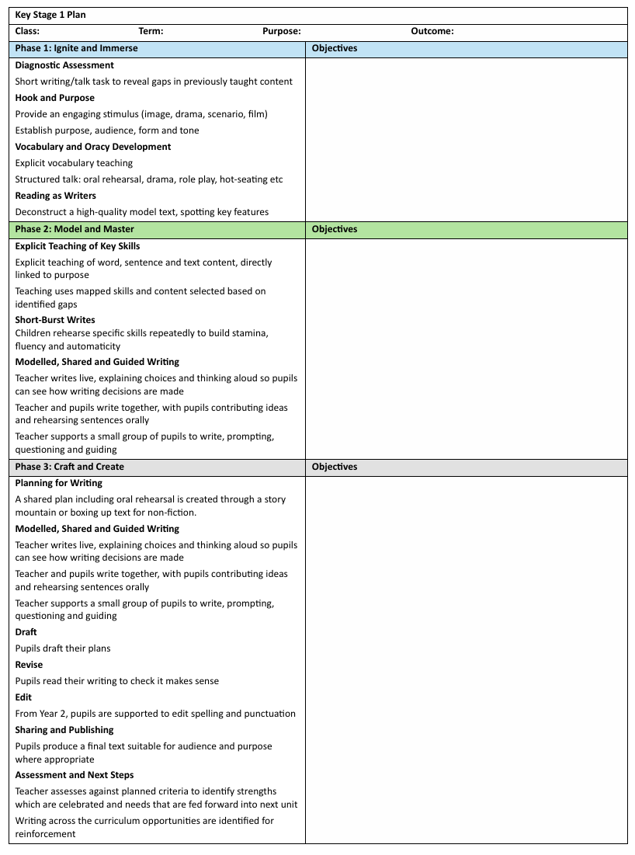
Key Stage 1 Planning

Slide 45
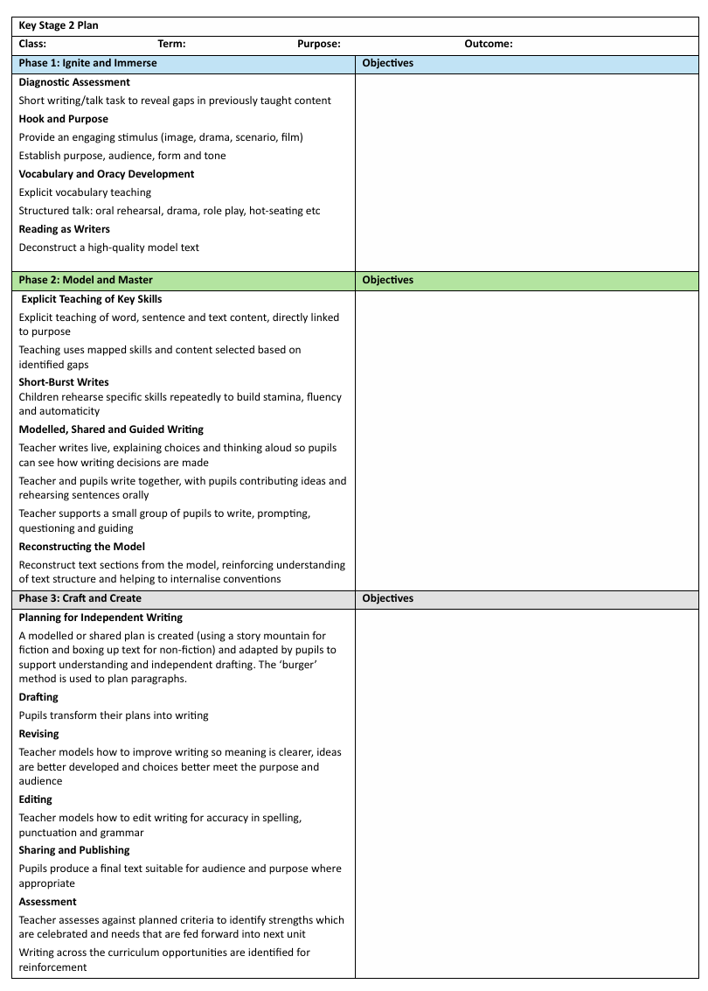
Key Stage 2 Planning

