Slide 1
DT Unit Design

Slide 2
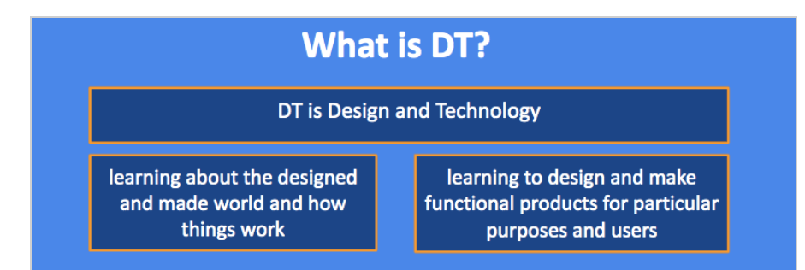
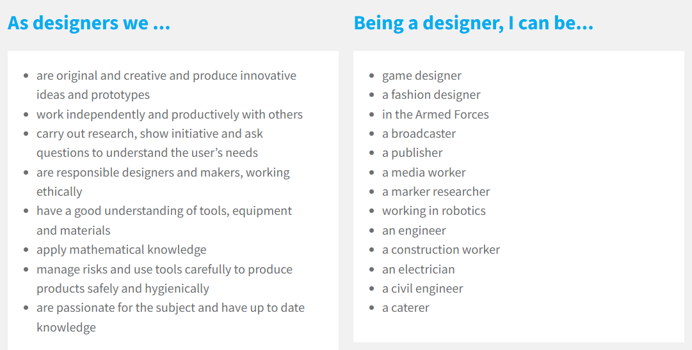

Slide 3
Previous End Point Assessment
Pupils complete the quiz from the previous unit – this might be from the term before or, if after the summer holidays, the school year before. It may be different depending on year group.
Do not worry about complete these if they are not yet available.

Slide 4
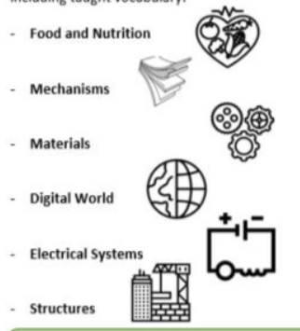
What are we learning about in this topic? What is the outcome?
Teacher shares the overarching topic, ‘aspect’ of DT (food and nutrition, mechanisms, materials, digital world, electrical systems or structures) and outcome of the unit.
Outcome:

Slide 5
Previous Aspect Discussion
Children share what they know from when they last experienced the ‘aspect’ (i.e. food and nutrition). This may be from a year or two ago. Teacher uses the ‘key knowledge’ and skills to prompt discussion.

Slide 6
Share Previous Skills
Teacher also share which skills will also be covered in the unit and the previous skills that they pupils learnt.

Slide 7

Lesson 1:

Slide 8
Feedback to Feed Forward
Before the unit starts, use all of the discussions and assessments so far to address misconceptions.
You may need to recap prior learning a little more
Take time here as it’s important children have a solid foundation to build new learning too.

Slide 9
Vocabulary Check
Teacher revisits the vocabulary for this unit.

Slide 10
Retrieval from within Unit
The class review vocabulary and the learning from the previous lesson(s) and show where they are in the wider ‘DT journey’ (i.e. the sequence).

Slide 11
Share lesson ‘I can’
Look at ‘I can.’ for this lesson and how this fits into the bigger sequence of learning for the unit.

Slide 12
New Learning
Ensure learning is introduced in line with Walkthrus (small steps, modelled, checking for understanding etc…)
Teach new learning. Pupils will have the opportunity to practice their disciplinary skills within each lesson

Slide 13
Independent Practice
Learning presented in DT books – activity must be closely linked to the learning intention. Pupils may be given the opportunity to ‘present learning how they wish i.e. sketch, diagrams, piece of writing... Misconceptions picked up and addressed through effective deployment of LSAs, instant feedback and rapid support.

Slide 14
End of Lesson Assessment
Teacher reviews the learning within the lesson to measure whether pupils have understood.

Slide 15
Lesson 2:

Slide 16
Feedback to Feed Forward
Before the unit starts, use all of the discussions and assessments so far to address misconceptions.
You may need to recap prior learning a little more
Take time here as it’s important children have a solid foundation to build new learning too.

Slide 17
Vocabulary Check
Teacher revisits the vocabulary for this unit.

Slide 18
Retrieval from within Unit
The class review vocabulary and the learning from the previous lesson(s) and show where they are in the wider ‘DT journey’ (i.e. the sequence).

Slide 19
Share lesson ‘I can’
Look at ‘I can.’ for this lesson and how this fits into the bigger sequence of learning for the unit.

Slide 20
New Learning
Ensure learning is introduced in line with Walkthrus (small steps, modelled, checking for understanding etc…)
Teach new learning. Pupils will have the opportunity to practice their disciplinary skills within each lesson

Slide 21
Independent Practice
Learning presented in DT books – activity must be closely linked to the learning intention. Pupils may be given the opportunity to ‘present learning how they wish i.e. sketch, diagrams, piece of writing... Misconceptions picked up and addressed through effective deployment of LSAs, instant feedback and rapid support.

Slide 22
End of Lesson Assessment
Teacher reviews the learning within the lesson to measure whether pupils have understood.

Slide 23
Lesson 3:

Slide 24
Feedback to Feed Forward
Before the unit starts, use all of the discussions and assessments so far to address misconceptions.
You may need to recap prior learning a little more
Take time here as it’s important children have a solid foundation to build new learning too.

Slide 25
Vocabulary Check
Teacher revisits the vocabulary for this unit.

Slide 26
Retrieval from within Unit
The class review vocabulary and the learning from the previous lesson(s) and show where they are in the wider ‘DT journey’ (i.e. the sequence).

Slide 27
Share lesson ‘I can’
Look at ‘I can.’ for this lesson and how this fits into the bigger sequence of learning for the unit.

Slide 28
New Learning
Ensure learning is introduced in line with Walkthrus (small steps, modelled, checking for understanding etc…)
Teach new learning. Pupils will have the opportunity to practice their disciplinary skills within each lesson

Slide 29
Independent Practice
Learning presented in DT books – activity must be closely linked to the learning intention. Pupils may be given the opportunity to ‘present learning how they wish i.e. sketch, diagrams, piece of writing... Misconceptions picked up and addressed through effective deployment of LSAs, instant feedback and rapid support.

Slide 30
End of Lesson Assessment
Teacher reviews the learning within the lesson to measure whether pupils have understood.

Slide 31
Lesson 4:

Slide 32
Feedback to Feed Forward
Before the unit starts, use all of the discussions and assessments so far to address misconceptions.
You may need to recap prior learning a little more
Take time here as it’s important children have a solid foundation to build new learning too.

Slide 33
Vocabulary Check
Teacher revisits the vocabulary for this unit.

Slide 34
Retrieval from within Unit
The class review vocabulary and the learning from the previous lesson(s) and show where they are in the wider ‘DT journey’ (i.e. the sequence).

Slide 35
Share lesson ‘I can’
Look at ‘I can.’ for this lesson and how this fits into the bigger sequence of learning for the unit.

Slide 36
New Learning
Ensure learning is introduced in line with Walkthrus (small steps, modelled, checking for understanding etc…)
Teach new learning. Pupils will have the opportunity to practice their disciplinary skills within each lesson

Slide 37
Independent Practice
Learning presented in DT books – activity must be closely linked to the learning intention. Pupils may be given the opportunity to ‘present learning how they wish i.e. sketch, diagrams, piece of writing... Misconceptions picked up and addressed through effective deployment of LSAs, instant feedback and rapid support.

Slide 38
End of Lesson Assessment
Teacher reviews the learning within the lesson to measure whether pupils have understood.

Slide 39
Lesson 5:

Slide 40
Feedback to Feed Forward
Before the unit starts, use all of the discussions and assessments so far to address misconceptions.
You may need to recap prior learning a little more
Take time here as it’s important children have a solid foundation to build new learning too.

Slide 41
Vocabulary Check
Teacher revisits the vocabulary for this unit.

Slide 42
Retrieval from within Unit
The class review vocabulary and the learning from the previous lesson(s) and show where they are in the wider ‘DT journey’ (i.e. the sequence).

Slide 43
Share lesson ‘I can’
Look at ‘I can.’ for this lesson and how this fits into the bigger sequence of learning for the unit.

Slide 44
New Learning
Ensure learning is introduced in line with Walkthrus (small steps, modelled, checking for understanding etc…)
Teach new learning. Pupils will have the opportunity to practice their disciplinary skills within each lesson

Slide 45
Independent Practice
Learning presented in DT books – activity must be closely linked to the learning intention. Pupils may be given the opportunity to ‘present learning how they wish i.e. sketch, diagrams, piece of writing... Misconceptions picked up and addressed through effective deployment of LSAs, instant feedback and rapid support.

Slide 46
End of Lesson Assessment
Teacher reviews the learning within the lesson to measure whether pupils have understood.

Slide 47
Creation of Product and Evaluation
Children will apply their learning skills to create the final product in the make phase of learning. Children will then evaluate their product using the correct format.

Slide 48
Complete End of Unit Assessment
Children are given a quiz that contains the key knowledge at the end of each unit.
Record Assessments

