Slide 1
History Unit/Lesson Design

Slide 2
Starting a Unit

Slide 3
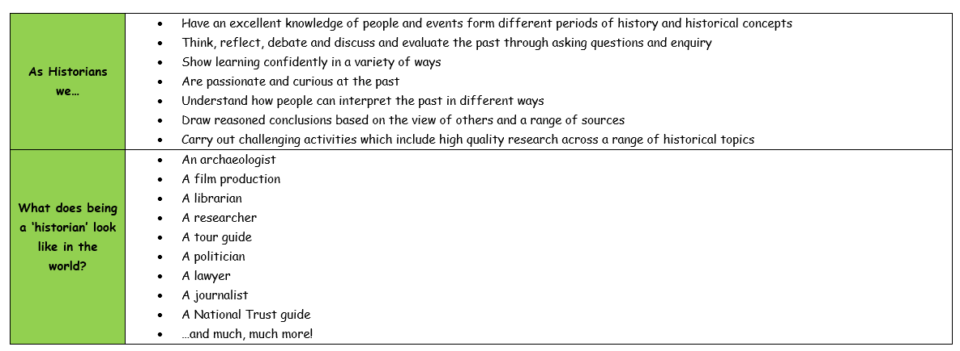
What is history?

Slide 4
Previous End Point Assessment
Complete the previous quiz from the last term (this might be different for different children i.e. in the autumn term, year 2 will complete one from year 1 but in year 3 they might complete one from year 2. however, in the spring term, they will all complete the quiz from the autumn term).
Do not worry about complete these if they are not yet available.

Slide 5
Previous Concept Discussion
Look back from when the concepts were last taught – recap what the children remember.

Slide 6
Unit Activation of Prior Knowledge
Complete the 3 tasks on the agreed format.

Slide 7
Feedback to Feed Forward
Before the unit starts, use all of the assessments so far to address misconceptions.
You may need to recap prior learning a little more
Take time here as it’s important children have a solid foundation to build new learning too.

Slide 8
Unit Launch & Unit Concepts
Share Overarching Enquiry Question and Unit Concepts

Slide 9
Lesson 1: Feedback to Feedforward
Start lesson by addressing misconceptions.

Slide 10
Lesson 1: Timeline Knowledge
Use a timeline to put today’s lesson into context. (this slide can be repeated each lesson as a reminder)

Slide 11
Lesson 1: Vocab Check
Which vocab will we be covering today?
What vocab have we used so far this unit?

Slide 12
Lesson 1: Retrieval from within Unit
What have we learnt so far this unit?

Slide 13
Lesson 1: Lesson Enquiry and concept skill for this lesson?
What ha

Slide 14
Lesson 1: New Learning

Slide 15
Lesson 1: Independent Practice
Start lesson by addressing misconceptions.

Slide 16
Lesson 1: End of Lesson Assessment
Start lesson by addressing misconceptions.

Slide 17
Lesson 2: Repeat for new lesson
Some slides won’t have to change.

